Slide 1
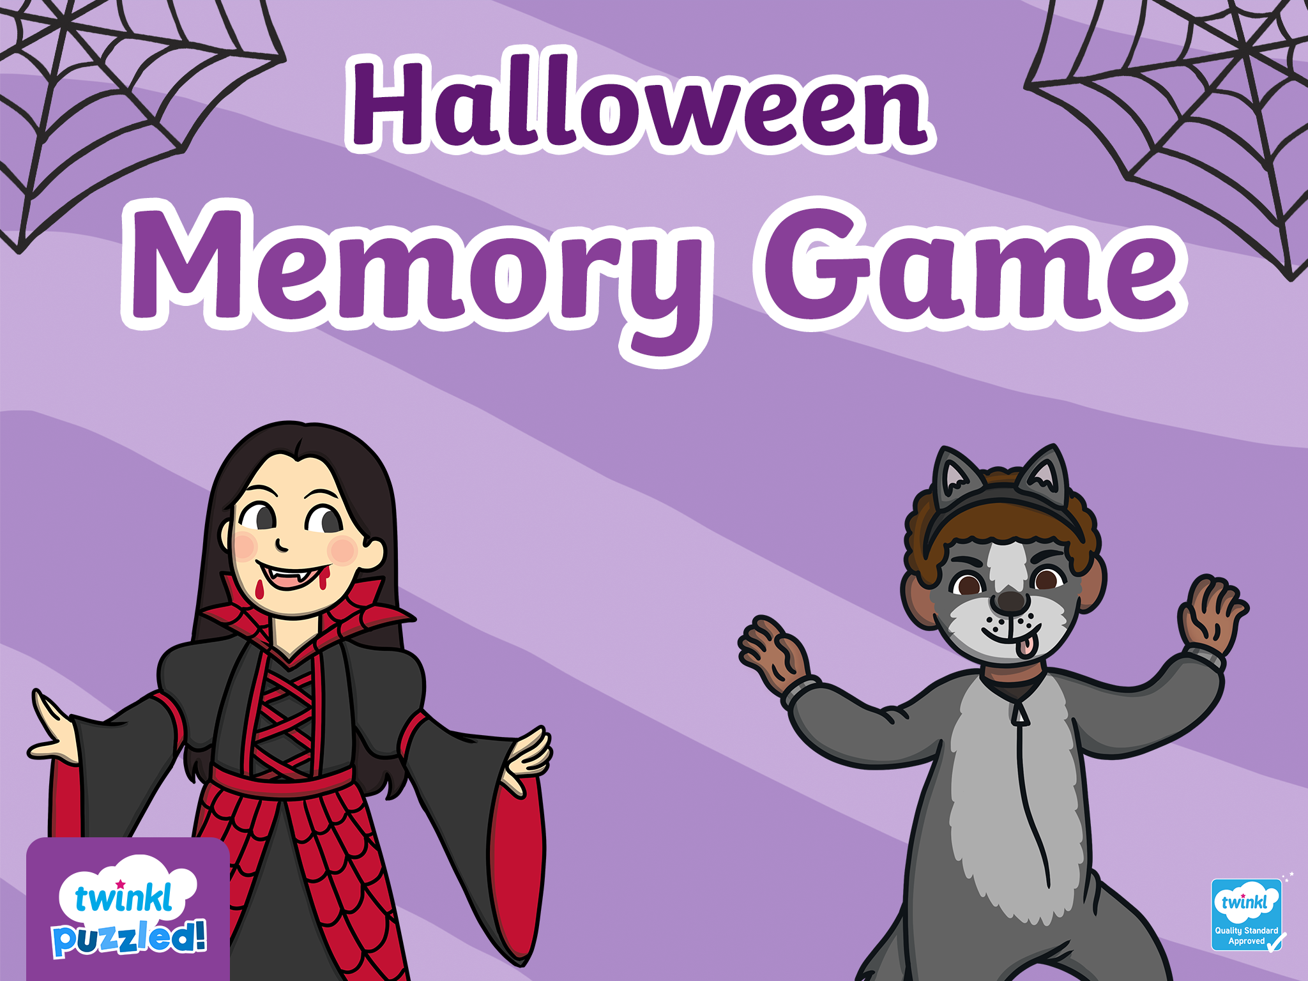
Start

Slide 2


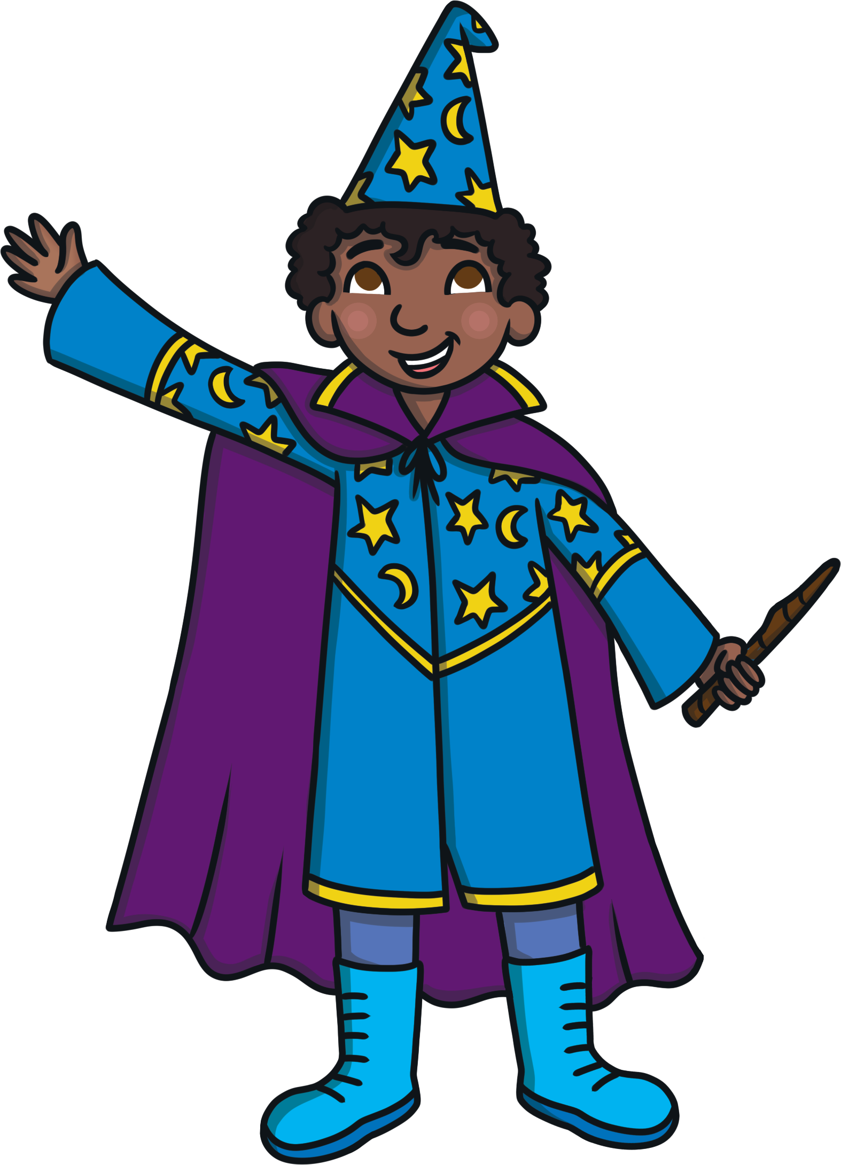
Abracadabra - one item has gone!
Can you remember and work out which one?
Start

Slide 3

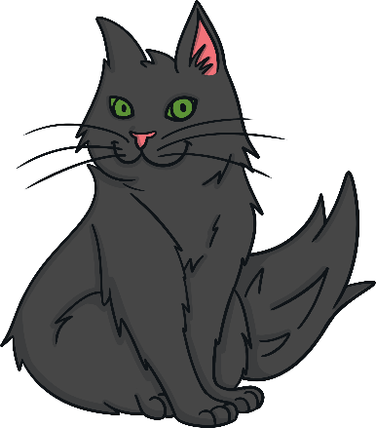


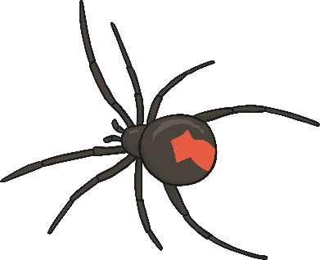

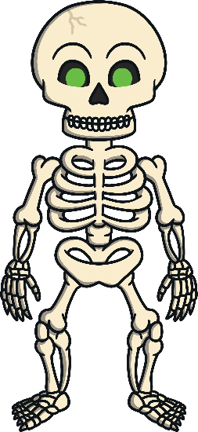
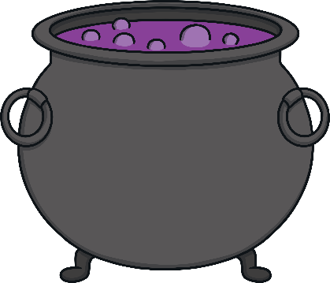
Memorise the items on the table
Ready?

Slide 4

Abracadabra!

Slide 5
What item is missing?
Reveal Answer

Slide 6
The eyeball was missing!
Next

Slide 7
Memorise the items on the table
Ready?

Slide 8
Abracadabra!

Slide 9
What item is missing?
Reveal Answer

Slide 10
The bat was missing!
Next

Slide 11
Memorise the items on the table
Ready?

Slide 12
Abracadabra!

Slide 13
What item is missing?
Reveal Answer

Slide 14
The sweets were missing!
Next

Slide 15
